Slide 1

AMD AI DevMaster Hackathon
shengyaqingfeng@gmail.com
AMD AI Developer Program No.00000587
https://github.com/creazyboyone

Slide 2
Track 2, individually, HadoopAIOps
An LLM-powered ReAct agent platform for autonomous big data cluster operations — automatically inspecting, diagnosing, and repairing Hadoop/HBase/Hive clusters with risk-tiered approvals, a self-learning knowledge base, and a web console.

Slide 3
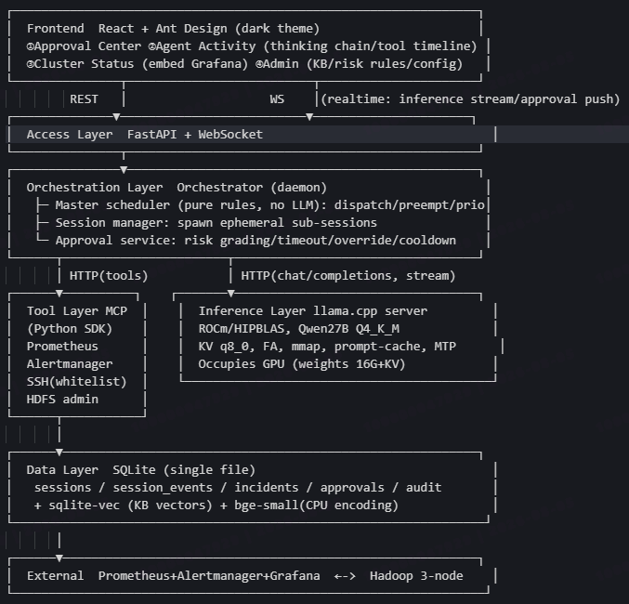











Track 2, individually, HadoopAIOps
Autonomous Hadoop Cluster Operations on AMD Radeon GPU

